Slide 1
Agile Software Development
Agility and Process
Dr. Farrukh Zeshan

Slide 2
Agile Software Development
Agile software development is an iterative approach to software development that emphasizes flexibility and collaboration. (small, working increments of software in short sprints, rather than one large release)

Slide 3
Agile Software Development
Identify the problem: Start by understanding the problem that needs to be solved and defining the goal of the software.
Form a cross-functional team: Assemble a team of developers, designers, testers, and other stakeholders who will be responsible for building the software. Giving them the freedom and authority to make decisions about how best to complete their work.

Slide 4
Agile Software Development
3. Create a product backlog: Write down all the features and requirements of the software in the form of user stories. This is called the product backlog.
4. Prioritize the backlog: Prioritize the user stories in the backlog based on their importance and dependencies.
5. Plan the sprint: Select the most important user stories from the backlog and plan the sprint. A sprint is a short iteration of work, usually two to four weeks, during which the team will work on delivering a usable portion of the software.

Slide 5
Agile Software Development
6. Start the sprint: Begin working on the user stories selected for the sprint. Use daily stand-up meetings to communicate progress and identify any obstacles that need to be addressed.
7. Continuously integrate and test: As the team works on the user stories, continuously integrate the changes into the codebase and test the software to ensure it works as expected.

Slide 6
Agile Software Development
8. Review and retrospective: At the end of the sprint, conduct a review with stakeholders to demonstrate the work completed and gather feedback. Also, have a retrospective with the team to reflect on what went well and what can be improved.
9. Repeat: Repeat the sprint process, incorporating feedback from the review and retrospective, until the software is complete and meets the desired specifications.

Slide 7
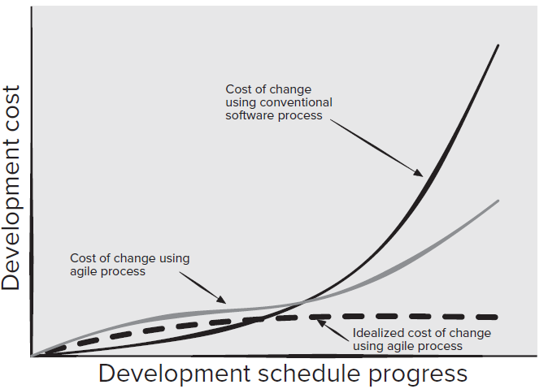

Slide 8
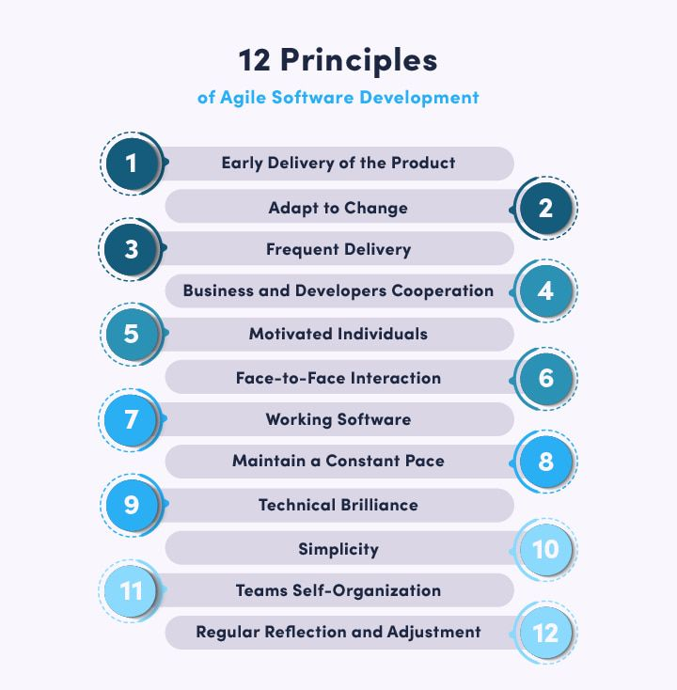

Slide 9
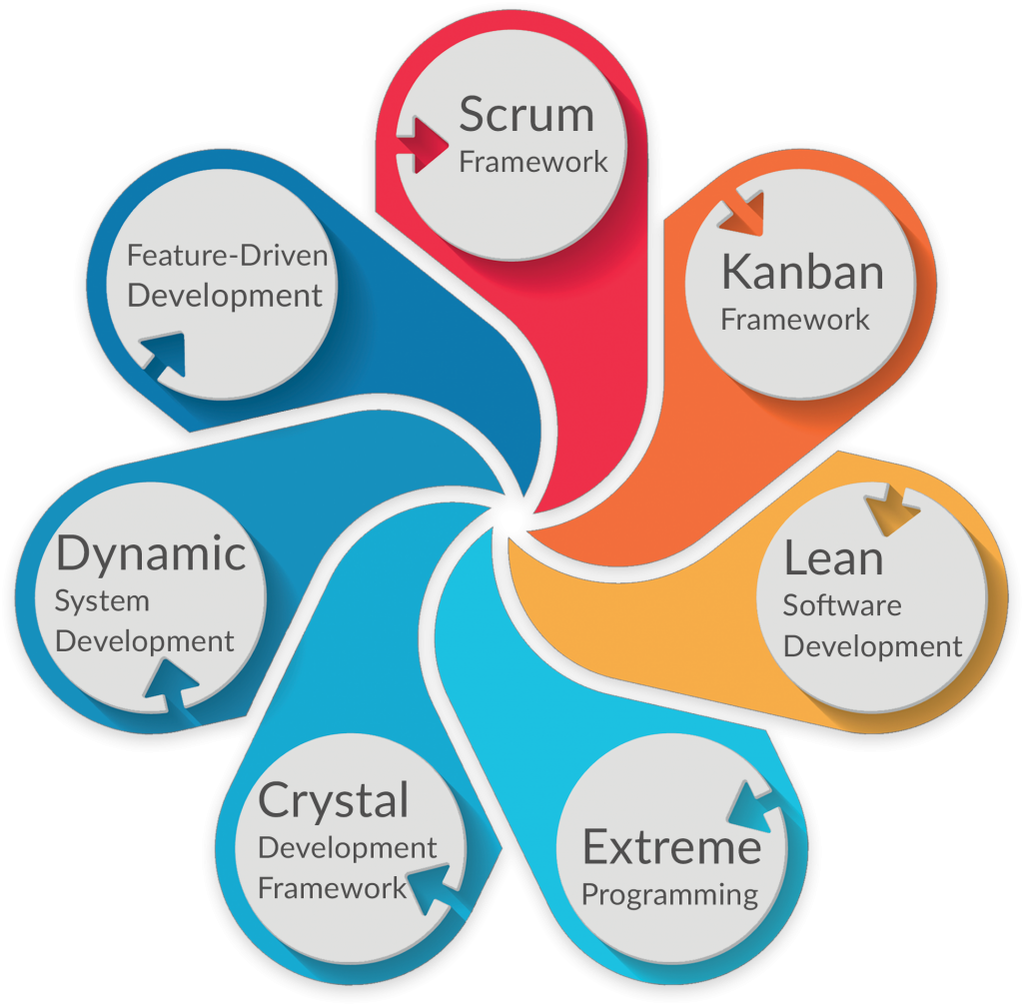
Agile Methodologies

Slide 10
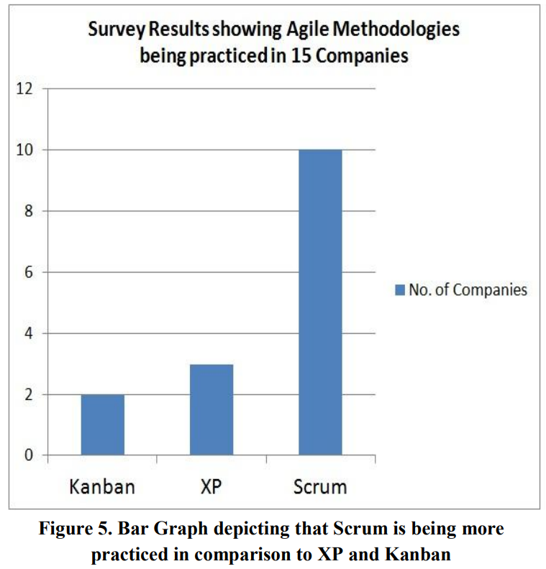

Slide 11
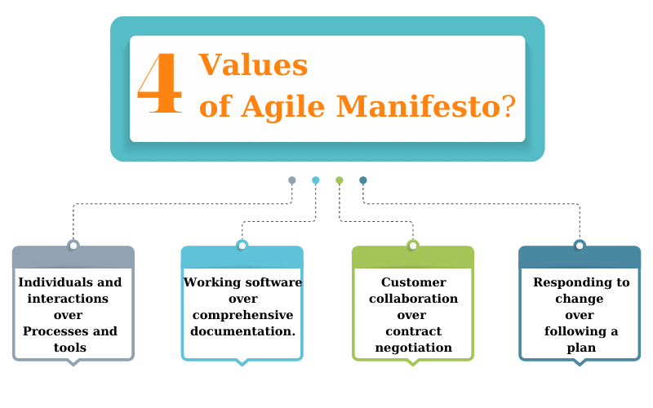

Slide 12
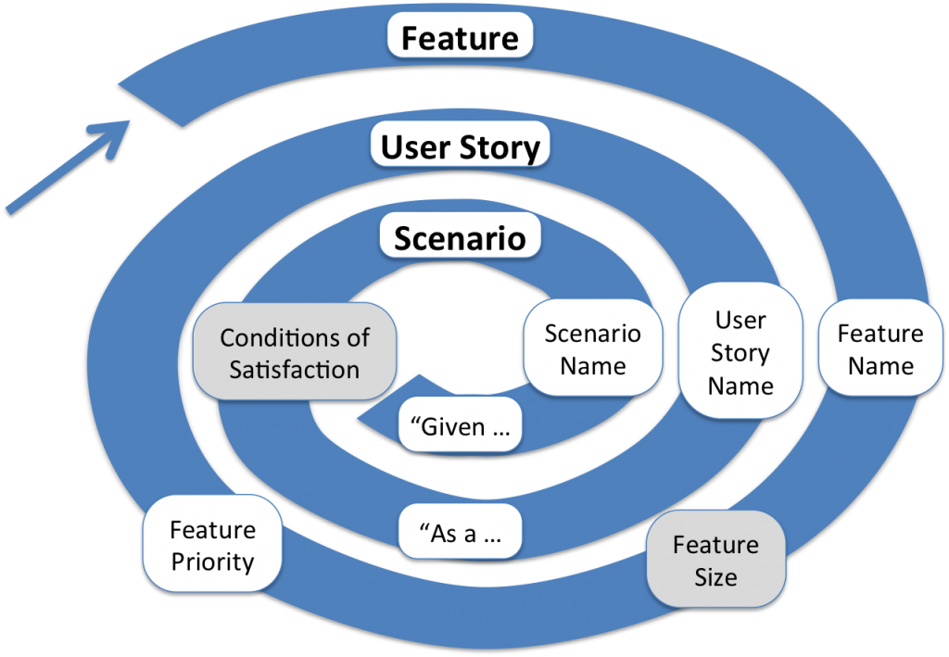
Agile Requirements

Slide 13
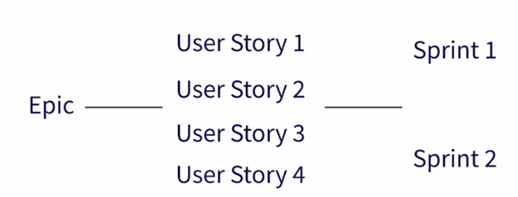
Agile Requirements
Feature /

Slide 14
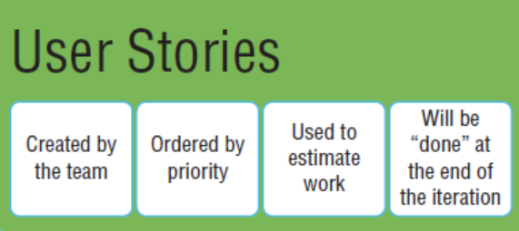
Agile Requirements

Slide 15
Refining Requirements
Feature / Epic
  Name
  Size [Optional]
  Priority
User Story
  Name
  “As <user role> I want to <action> so that <goal>”
  Conditions of Satisfaction [Optional]

Slide 16
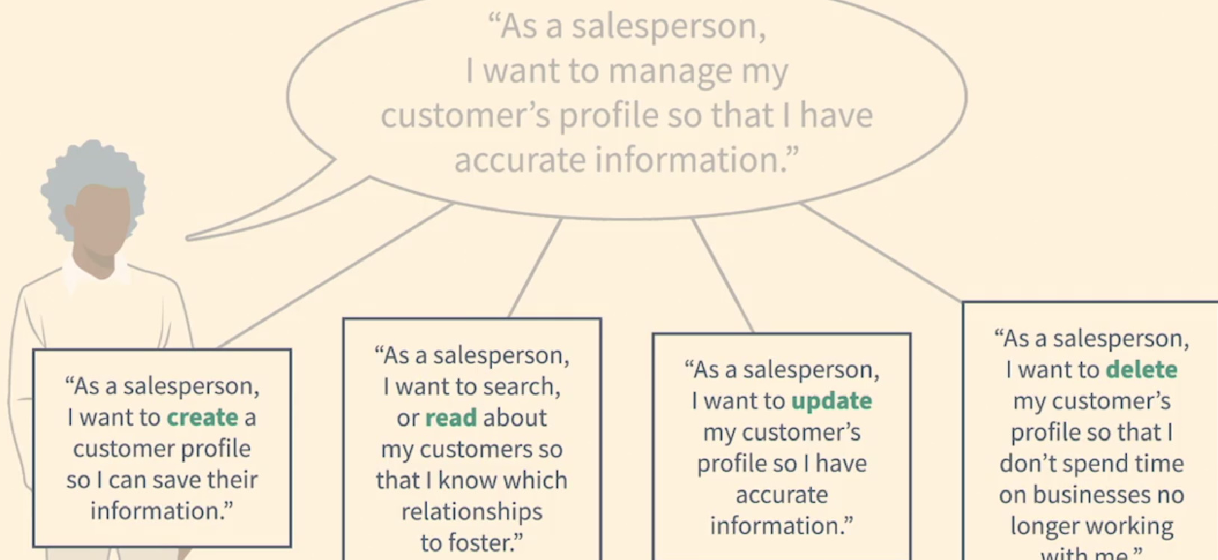
Refining Requirements

Slide 17
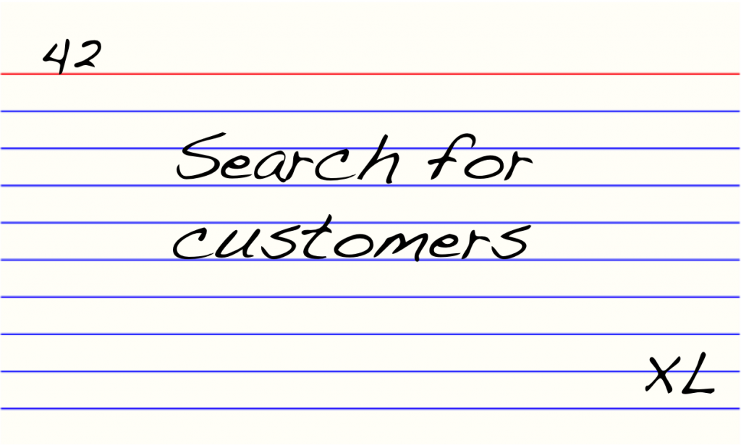
Feature

Slide 18
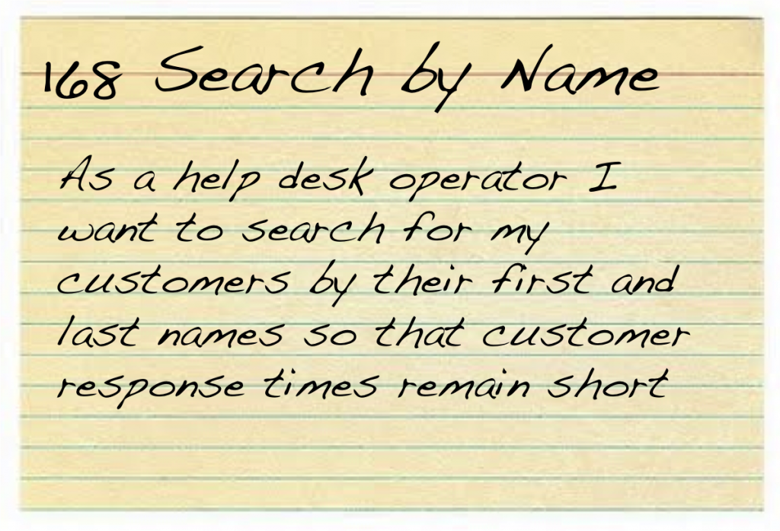
User Story
User Story
  Name
  “As <user role> I want to <action> so that <goal>”
  Conditions of Satisfaction [Optional]

Slide 19
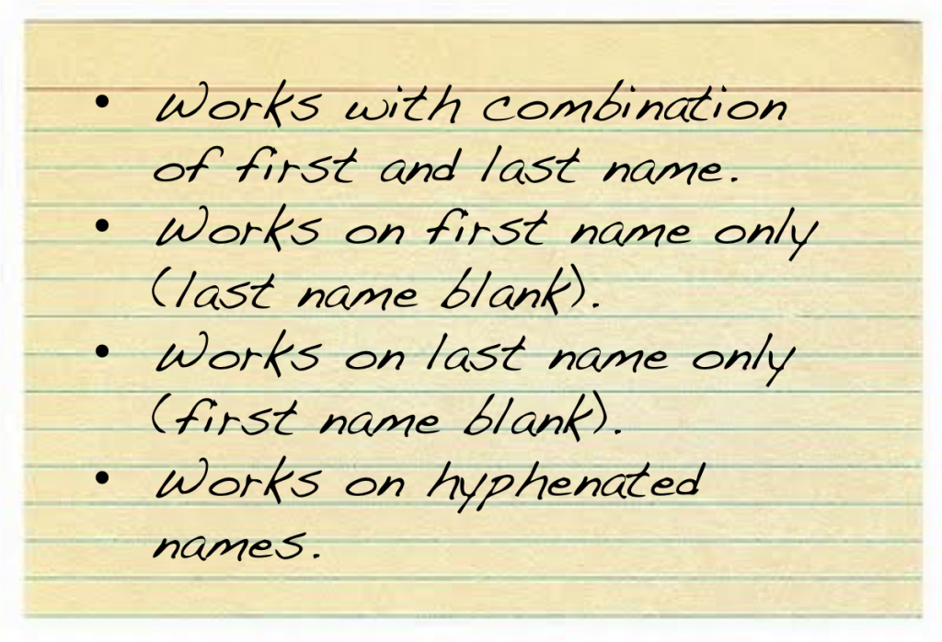
Scenarios
Scenario
  Name
  “Given <precondition> When <trigger> Then <result>”

Slide 20
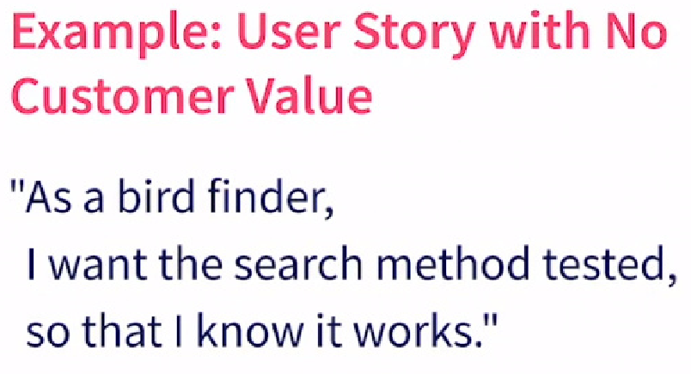
Agile Requirements: user story

Slide 21

As a marketing manager, I want a new page on our website, so that we can be more modern.
As a user, I want a pop-up confirmation dialog to appear when I click the 'Save' button, so that I can confirm my action.
As a customer, I want a button that changes the background color of the page.

Slide 22
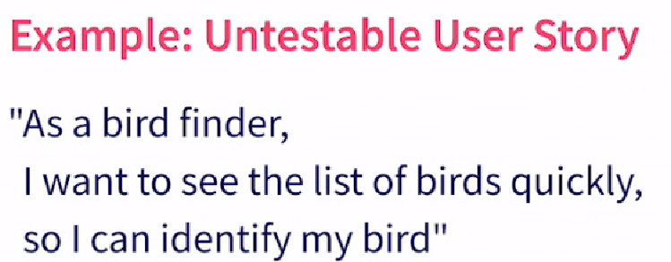
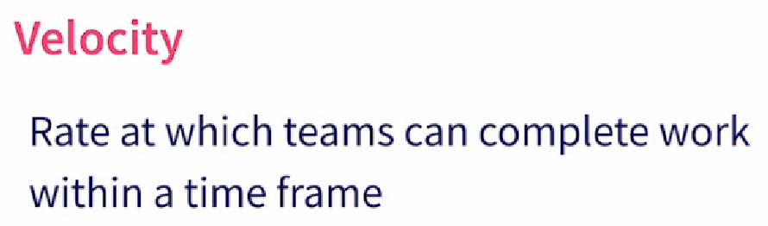

Slide 23
As a user, I want the website to be fast, so that I don't get frustrated.
As a customer, I want a better checkout experience, so that I complete my purchases.
As a user, I want the app to look beautiful, so that I enjoy using it.

Slide 24
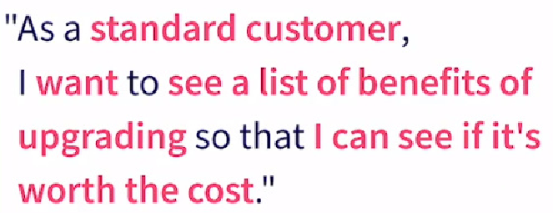
User Story
Deliver Customer Value ?
Is Testable ?

Slide 25
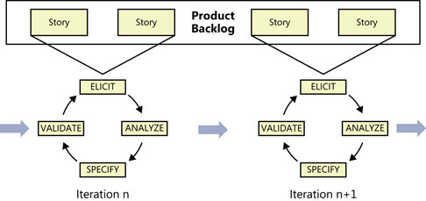

Slide 26
Product Backlog
Product Backlog includes the product features.
Big project’s features often need to be cut into the pieces.
Product manager/ product owner and team members determine how much work is needed to complete each features.
Prioritize each features.

Slide 27
Product Backlog
All the items in the backlog are ordered depending on their business value.
The higher the specific item is, the sooner developers will work on it.
The top-located items will be more detailed and clearer in comparison with the lower items.

Slide 28
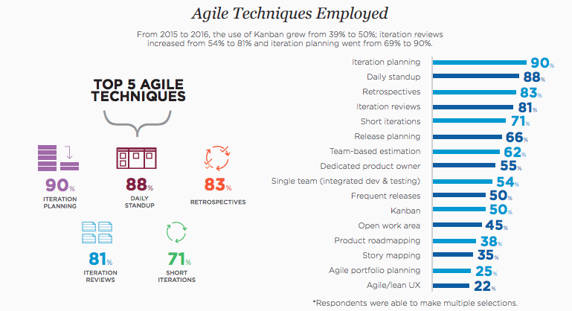

Slide 29
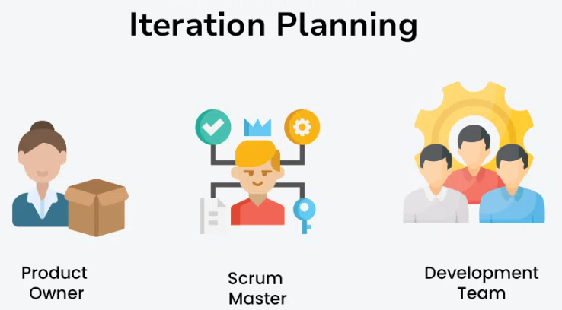
Backlog | Team | Stories with Points
Stories | Story Point Assessment
Velocity

Slide 30
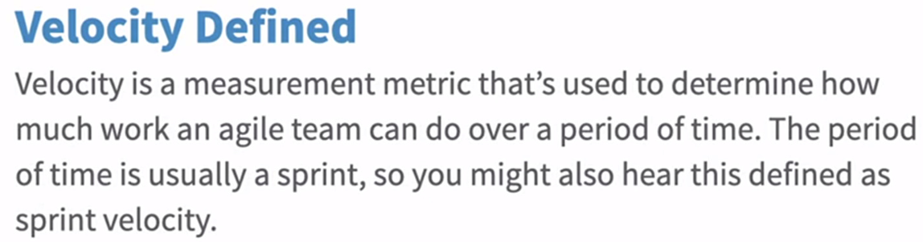
Velocity
Velocity is basically how much work can we accomplish in a specific time period.
Amount of story points to be calculated in any given iteration and then looking back when the iteration is over and figuring out what really got done.

Slide 31
WIP Limit
The team also wants to limit work in progress (WIP) or set WIP limits so that too much work isn’t pulled in at one time, which could create an overflow of work into the next iteration

Slide 32
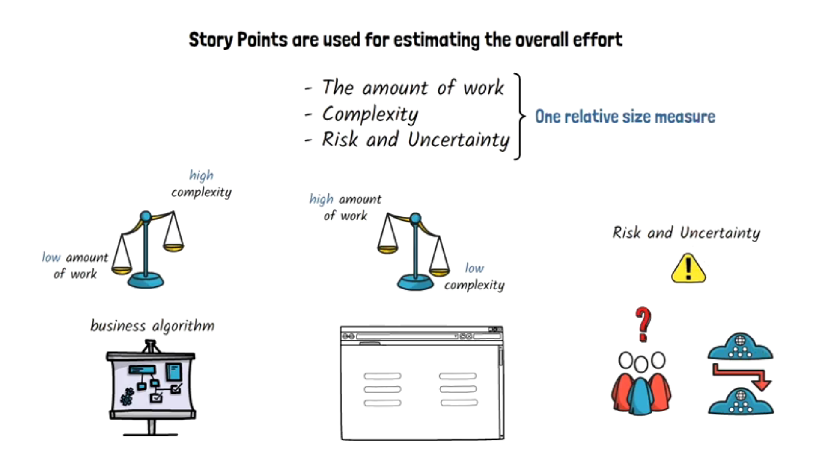
Wideband Delphi technique (planning poker): techniques to determine story sizes or story points.

Slide 33
Story Point Estimation
As a user, I want to reset my password so that I could access to my account.
Estimates:
  Team member A: 3
  Team member B: 5
  Team member C: 8
Discussion:
  A thinks it's a simple form of account.
  B is concerned about validation and security.
  C mentions integration with an external service and potential edge cases.
After Discussion:
  Team agrees on the complexity and settles on 5 story points.

Slide 34
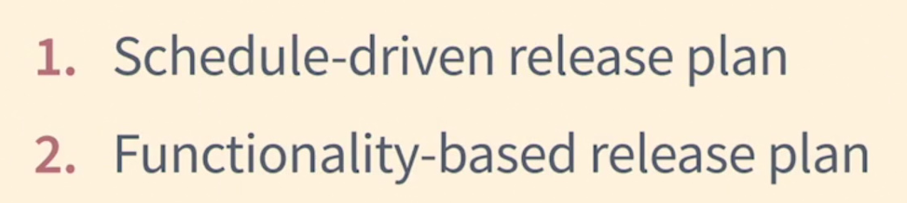
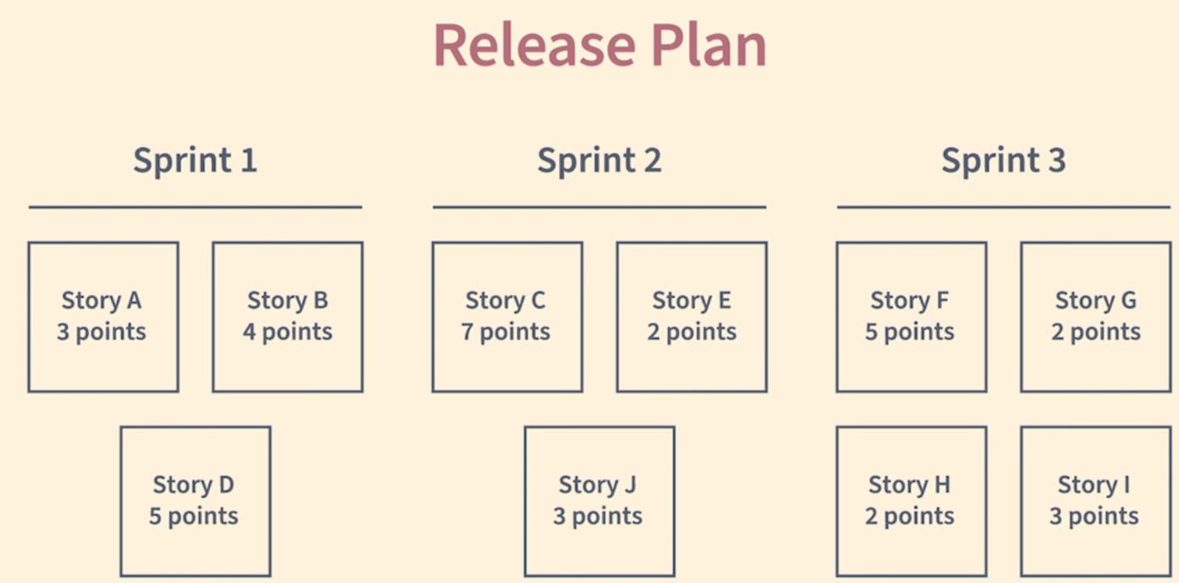

Slide 35
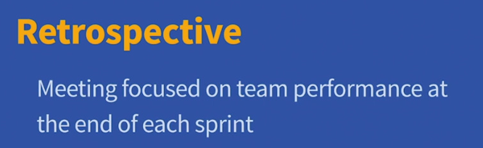
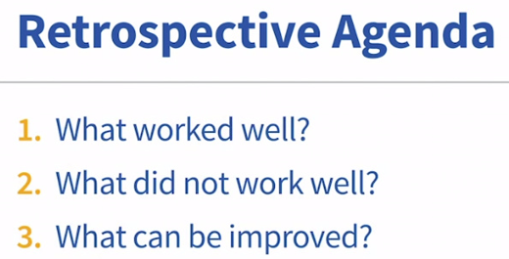

Slide 36
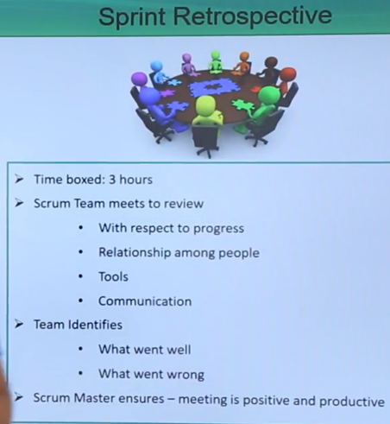

Slide 37
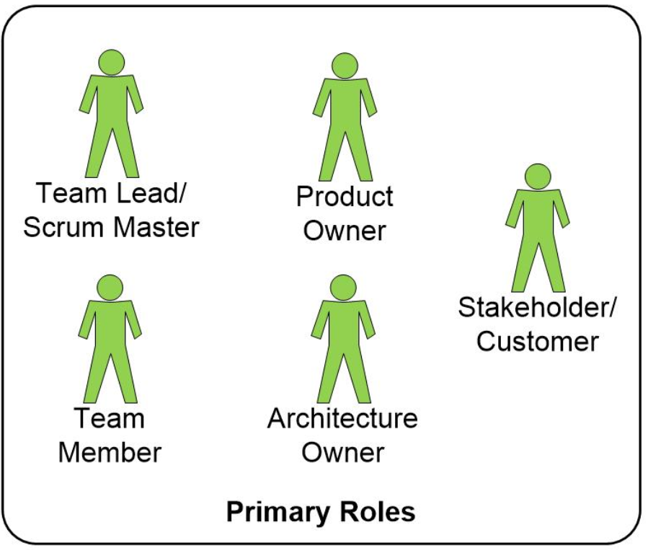

Slide 38
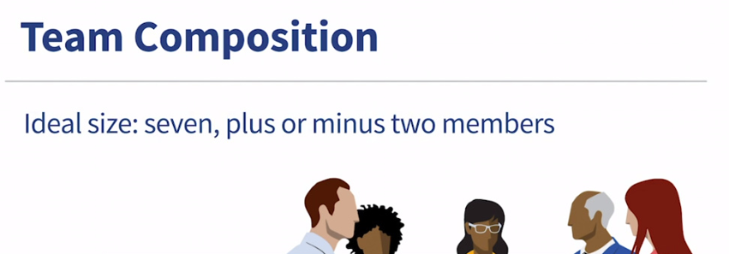
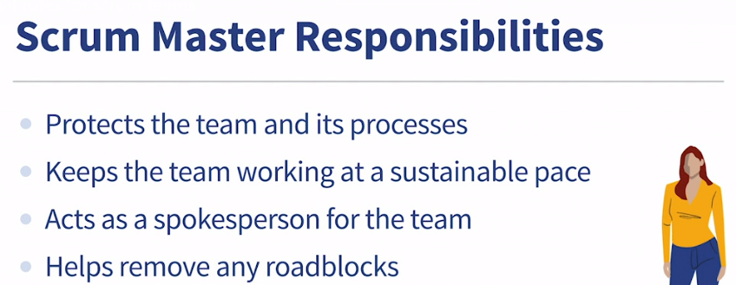

Slide 39
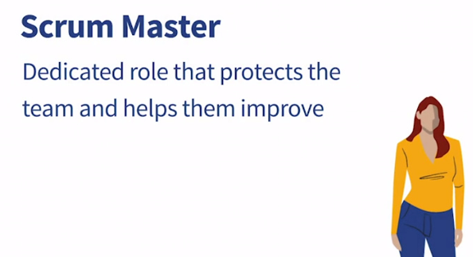
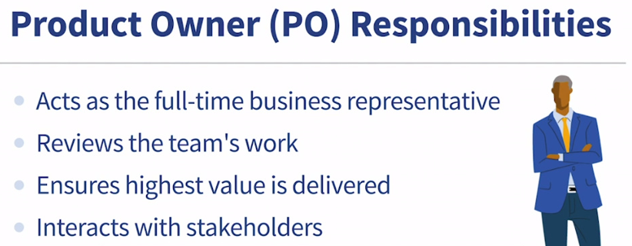

Slide 40
Development Team
Teams to nine or fewer People
Too many people, and the complexity of communication
Too much work mean too many clothes into the washer than it can handle, and the result is that nothing gets totally clean. Over time, it would reduce performance

Slide 41
Agile Advantages
Is a very realistic approach to software development.
Functionality can be developed rapidly and demonstrated.
Resource requirements are minimum.
Suitable for fixed or changing requirements
Minimal rules, documentation easily employed.
Gives flexibility to developers.

Slide 42
Agile Disadvantages
Little or no planning required.
Not suitable for handling complex projects.
More risk of maintainability and extensibility.
Depends heavily on customer interaction, so if customer is not clear, team can be driven in the wrong direction.
There is a very high individual dependency, since there is minimum documentation generated.
Transfer of technology to new team members may be quite challenging due to lack of documentation.

Slide 43
Meetings
Scrum meetings / Daily Standup
This event is a daily short morning meeting, arranged usually by a product manager or a product owner. It lasts 10-15 minutes and requires the presence of the Scrum master and the whole team.
The meeting has three main issues to discuss:
  to remember what was done yesterday
  to define the current goals
  to reveal any obstacles

Slide 44
Meetings
Sprint demo meetings
Meeting is arranged to explain functionality to the client, how it works. Customers can confirm that they accept all features and that they were made in accordance with their expectations and requirements?

Slide 45
Burndown Charts
Visual representation of progress to predict if they will complete the work on time (typically over a sprint or a release).
This chart demonstrates whether all the things really go according to the calendar of programming and the total plan. It reflects the work schedule and timing. Burndown charts will also show the number of user stories per unit of time, below or above your plan.

Slide 46
Burndown Charts
Day | Stories Points Completed | Total Points Remaining
1 | 5 | 45
2 | 8 | 37
3 | 3 | 34
4 | 0 | 34
5 | 10 | 24
6 | 7 | 17
7 | 9 | 8
8 | 5 | 3
9 | 3 | 0
10 | 0 | 0

Slide 47
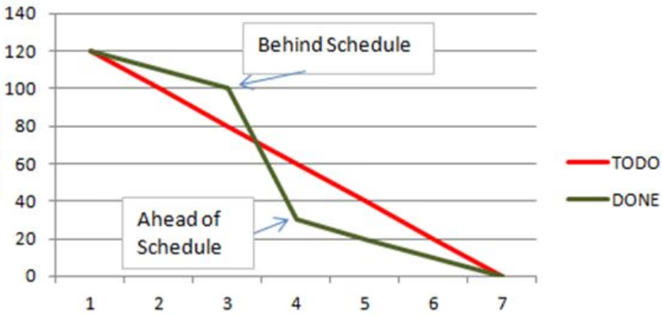
Burndown Charts

Slide 48
Automated Tests
Any regression test is run automatically before starting work. It ensures that all code changes are acceptable.
Regression testing is a type of software testing performed to ensure that a recent code change (like a new feature or a bug fix) does not adversely affect existing, unchanged functionality.

Slide 49
Fail Fast
If something is going to fail, it's best to find out immediately, before significant time, money, and effort are wasted.
If you built the wrong thing this sprint, you only wasted two weeks, not two years. You can change direction immediately for the next sprint.
In traditional, plan-driven projects (Waterfall), failure is often discovered very late—during final testing or even after launch. At this point, the cost of change is astronomically high, and the entire project can be jeopardized.

Slide 50
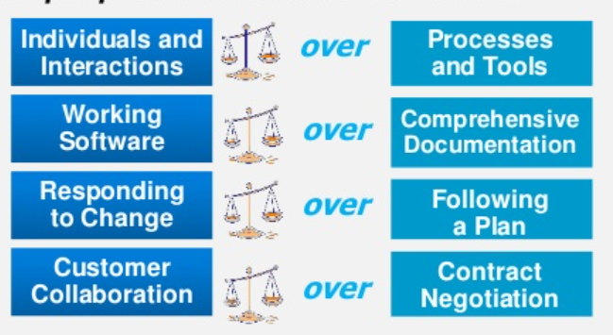
Agile Vs Traditional Models

Slide 51
Agile Requirements Management
Product statement
Product backlog
User stories
Use cases
Requirement prioritization
etc

Slide 52
Design
Architectural spikes
CRC cards
Etc.
High-level design is extended and adjusted to accommodate the new features
Architectural Spikes architectural spike typically happens between iterations or sprints to reduce the risk of a technical problem occurring later.

Slide 53
    Problem: A product team wants to add real-time collaborative editing (like Google Docs) to their web application.
The Uncertainty: The team has no experience with real-time technologies. They are unsure about the implementation approach, performance, and effort required.
As a development team, they need to investigate operational data stores and real-time sync frameworks (like Firebase, GunDB, or Y.js) to understand their feasibility, performance, and integration complexity for collaborative editing feature.

Slide 54
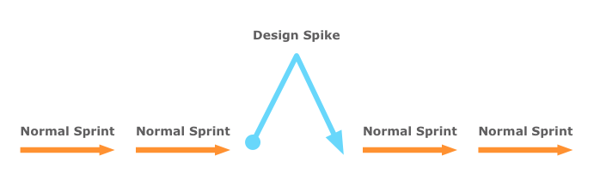
Time Box: 4 days
After 4 days, the team builds two small prototypes. They conclude that using a framework like Y.js is the most flexible and cost-effective option but will require more upfront development time. They present their findings and create a set of clear, well-defined user stories that can now be accurately estimated and prioritized.

Slide 55
CRC Cards
Class, responsibilities, and collaborators (CRC) cards are used to represent the responsibilities of classes and the interaction between the classes
Analysts create CRC cards by
  Finding all the nouns and verbs in a problem statement

Slide 56
Creating CRC Cards
Creating CRC cards, continued
  The group determines how tasks are fulfilled by objects or interacting with other things
  Responsibilities evolve into methods or operations

Slide 57
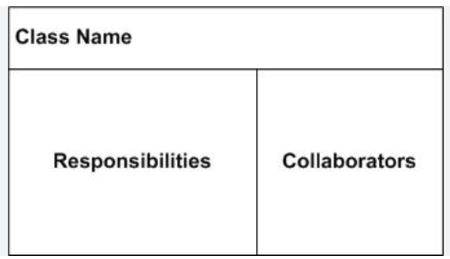
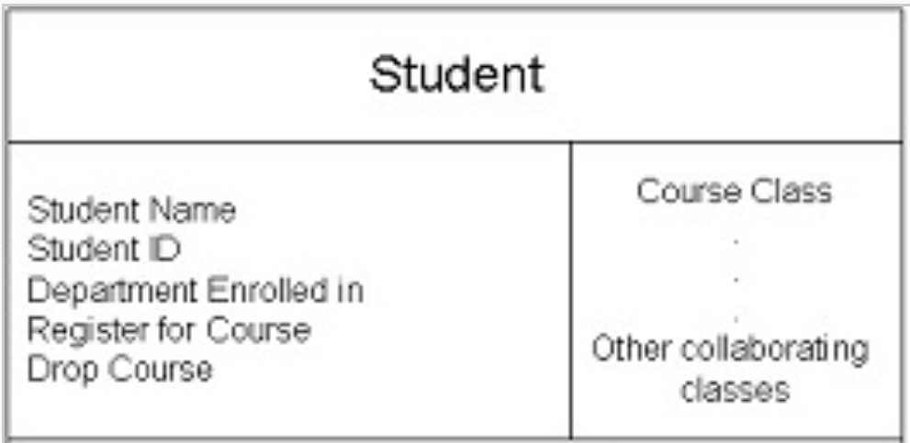

Slide 58

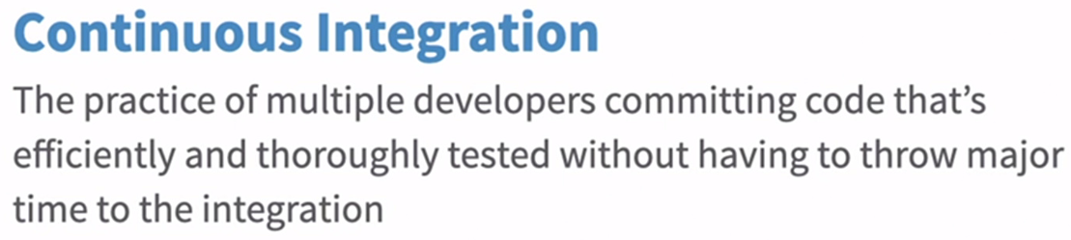
Development
Pair programming
Test driven development
Refactoring
Continuous integration
Frequent releases
etc

Slide 59
Testing
Unit testing
Integration testing
Regression testing
System testing
Etc.

Slide 60
Process
Backlog
Velocity
Spring planning
Sprint review
Burn down charts
Retrospective
etc

Slide 61
Organization
Small teams
Cross functional team
Self-organizing team
On-site customer
etc

Slide 62
ABC department of a university want a students management system to keep record of teachers, courses, students, attendance, registered courses and students marks. System should also facilitate the university department to assign courses to the teachers. The student and teachers have unique user name and password. System should allow registered students to search and register courses. Teacher can upload, modify and view students marks and attendance while student can only view the semester results, registered courses and attendance reports.

Slide 63
Refining Requirements

Slide 64
Feature

Slide 65
User Story
User Story
  Name
  “As <user role> I want to <action> so that <goal>”
  Conditions of Satisfaction [Optional]

Slide 66
Scenarios
Scenario
  Name
  “Given <precondition> When <trigger> Then <result>”

Slide 67

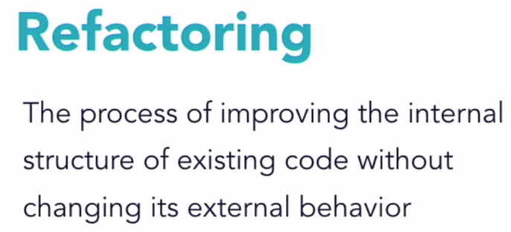

Slide 68
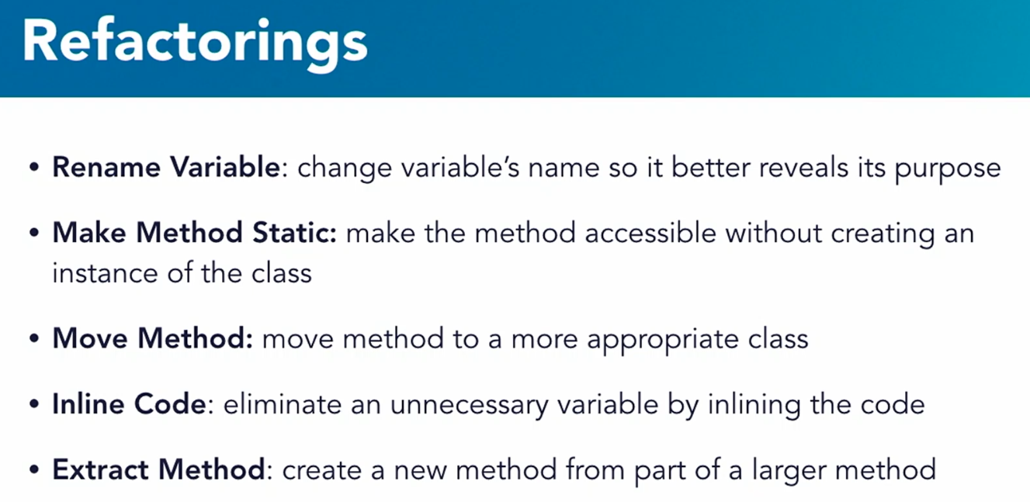

Slide 69
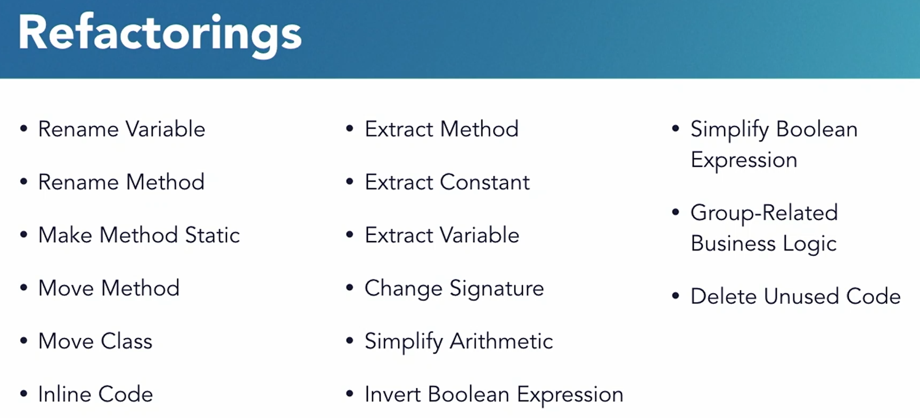

Slide 70
Inline Code
public String processOrder(Order order)
{ string result;
  if (order == null)
  { result = "Invalid order"; }
  else if (order.getItems().isEmpty())
  { result = "Empty order"; }
  else if (!order.isValid())
  { result = "Invalid order data"; }
  else
  { result = "Order processed: " + order.getId();
  }
  return result;
}

Slide 71
Inline Code
public String processOrder(Order order)
{
if (order == null) return "Invalid order";
if (order.getItems().isEmpty()) return "Empty order";
if (!order.isValid()) return "Invalid order data";
return "Order processed: " + order.getId();
}

Slide 72
Make Method Static
public class Calculator
{
private int instanceData;
public int add(int a, int b)
{
return a + b;
}
public double calcCircleArea(double radius)
{
return radius * radius;
}
}

Slide 73
Make Method Static
public class Calculator {
private int instanceData;
public static int add(int a, int b)
  {
  return a + b;
  }
public static double calcCircleArea(double radius)
  {
  return radius * radius;
  }
  }

Slide 74
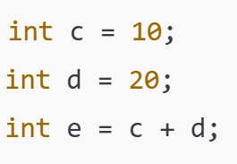
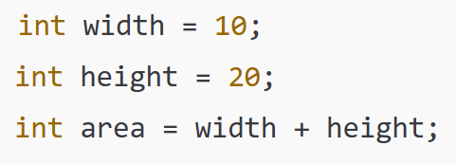
Code Refactoring
Rename Variable

Slide 75
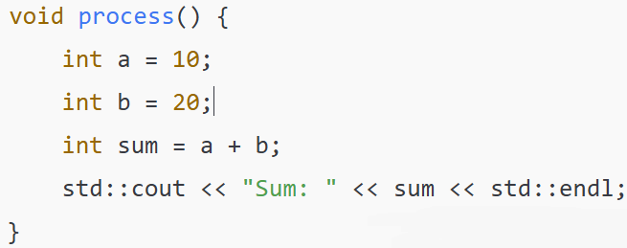
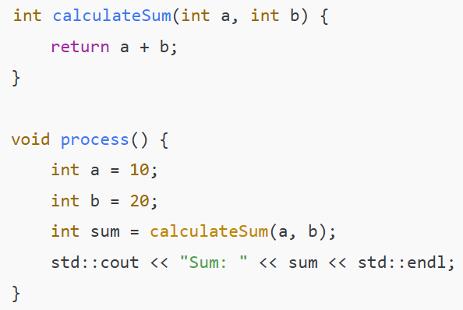
Method

Slide 76
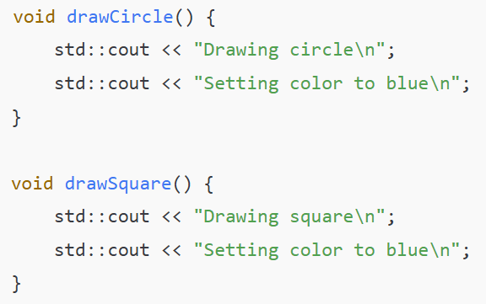

Slide 77
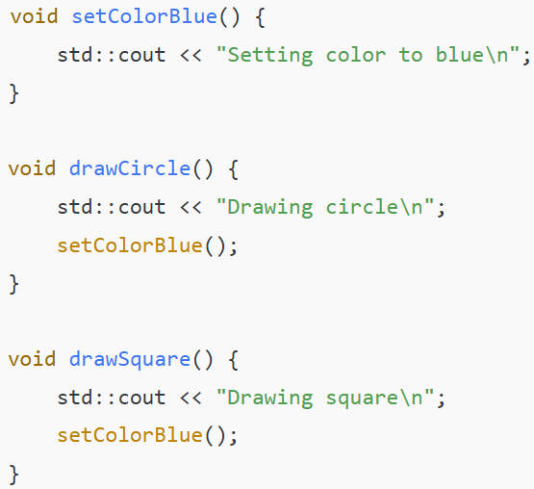

Slide 78
Rename Method &
Change Signature
public static int Method(int a, int b, char optr)
{
  If (optr == “+”)
  return a + b;
  If (optr == “-”)
  return a - b;
  If (optr == “*”)
  return a * b;
}

Slide 79
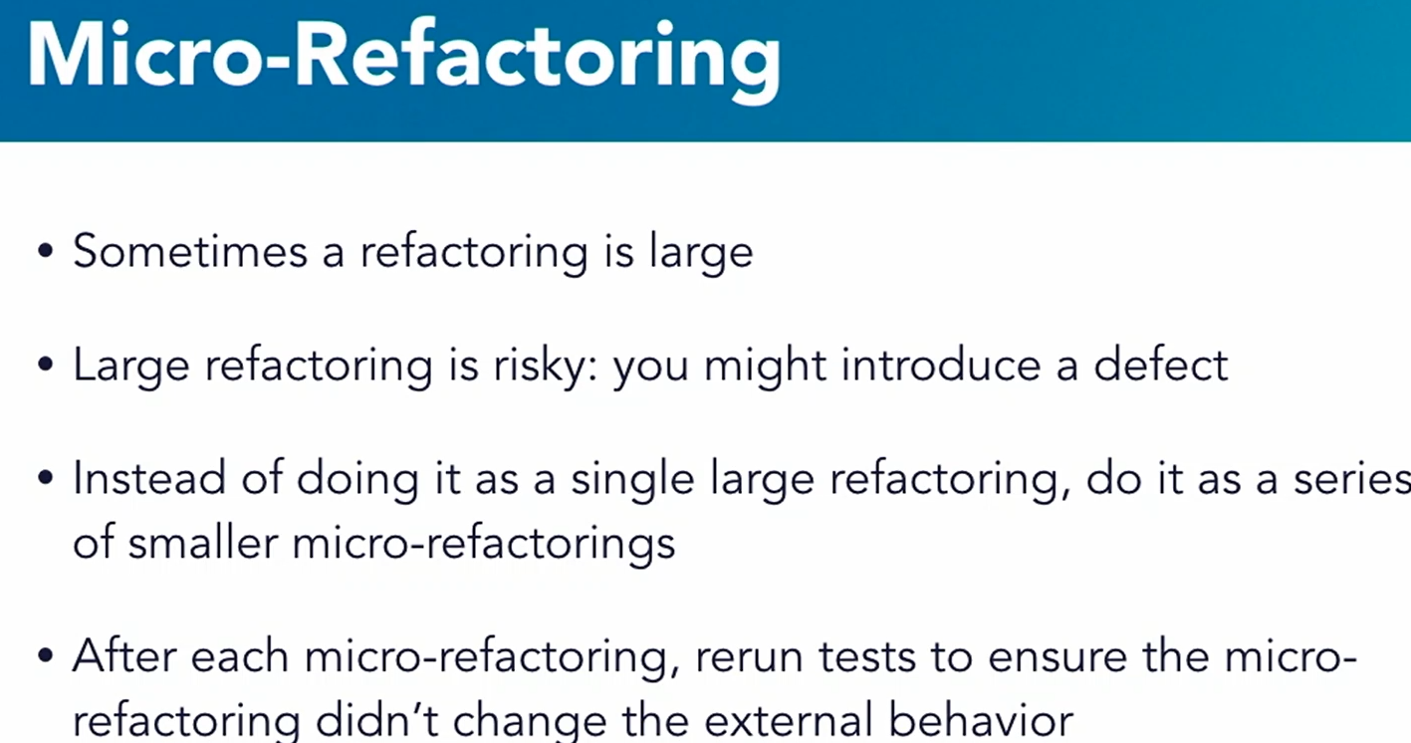

Slide 80

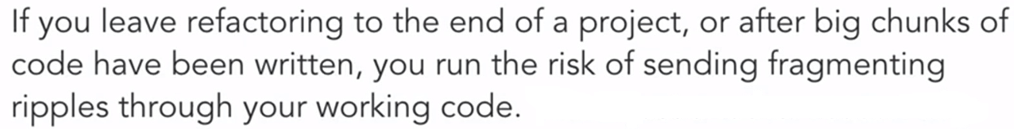

Slide 81
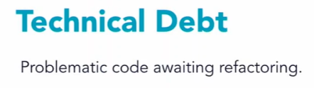
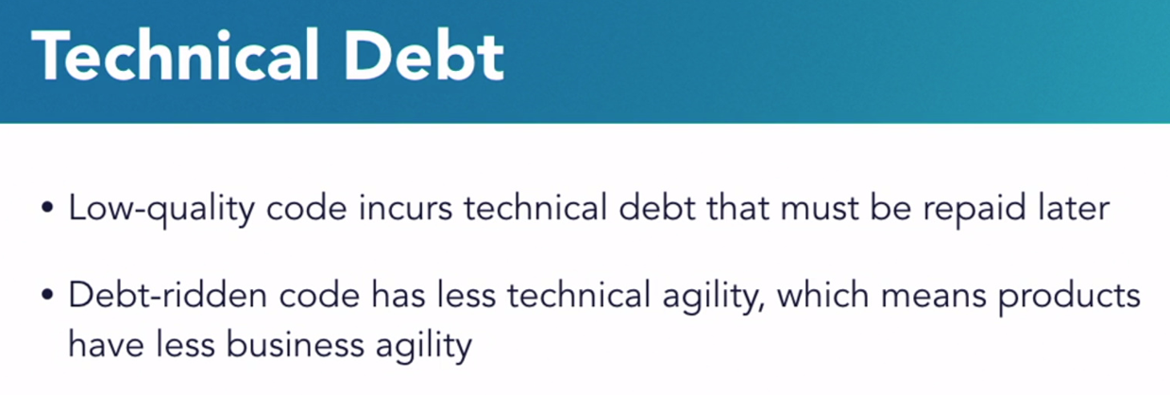

Slide 82
Common In Methodologies
The following seven properties are common to all of the methodologies:
1. Frequent delivery
2. Reflective improvement
3. Close communication
4. Personal safety
5. Focus
6. Easy access to expert users
7. Technical environment with automated tests, configuration management, and frequent integration

Slide 83
Frequent Delivery
Choosing a set of features to add high-level design is extended and adjusted to accommodate the new features.
Develop test integrate and evaluate an updated version of the software.
Deliver running, tested code to the users on a regular basis.
Project’s sponsors get solid information about the progress of the project.

Slide 84
Feedback
To get feedback from the users; real software should be delivered to real users.
Client has an opportunity to say “That’s not what I meant,” or change their mind when they see the results of their decisions.
The software can then better address the client’s needs

Slide 85
Reflective Improvement
Problems rarely go away by themselves, and to fix a problem you first must be aware of it
Many troubled projects have gone on to eventual success because the team took time out from their day-to-day development work to think about how to improve or fix their processes.
Hold a “reflection workshop” every few weeks to identify the practices, conventions, and habits that work, and to find alternatives for the ones that don’t.

Slide 86
Close Communication
In Close Communication the whole team is seated in the same room so that information flows effortlessly between them.
A question can be asked and answered in seconds, without interrupting either person’s flow of work.
This means that errors and misunderstandings can be corrected promptly, and that knowledge is disseminated quickly.
Junior developers can directly observe, copy, and learn from the more experienced members of the team.

Slide 87
Close Communication
By spreading information around the team, you considerably reduce the need for ineffective and labor-intensive documentation.
In fact, given that there’s rarely a dedicated tester on the team, the role is really that of “designer-programmer-tester.”

Slide 88
Personal Safety
“Personal safety” is not physical safety, but rather the psychological and emotional safety needed to speak up freely without fear.
There’s no point in organizing a reflection workshop if no one speaks up about the problems they’re facing.
Notes:
Some people show trust by default, whereas others only trust where they have seen positive evidence that trust is warranted. Gaining trust can be a slow process, so capable leaders will accelerate it by exposing themselves and their team to carefully chosen threats (for example, by revealing a weakness), and then showing that these lead to support, rather than hostility, and that there’s no risk of being hurt.

Slide 89
Personal Safety
When the results are on the wall for everyone to see, then people know who worked and who shirked, who spoke up and who kept quiet, who told the truth and who didn’t, and who can be trusted and who can’t.
Peer pressure will ensure that team members remain trustworthy and dependable
Notes:
Some people show trust by default, whereas others only trust where they have seen positive evidence that trust is warranted. Gaining trust can be a slow process, so capable leaders will accelerate it by exposing themselves and their team to carefully chosen threats (for example, by revealing a weakness), and then showing that these lead to support, rather than hostility, and that there’s no risk of being hurt.

Slide 90
Focus
The ability to focus on an individual task.
It may take 20 minutes to regain your train of thought after a phone call or a meeting, or more if it requires you to completely change tracks to discuss another project.
The clarity and sense of direction the team needs to achieve its purpose successfully.
Notes:
Managers commonly assign developers to two or more projects at a time, but the consensus is that by the time the third project is added, the developer ceases to make effective progress on any of them.
Crystal suggests two rules for dealing with these problems. The first is to define two-hour time windows when interruptions are blocked, because inter ruptions are rarely so critical that they can’t be delayed for an hour or two. The second is to specify that when a person starts work on a project, they’ll have at least two full days on that project before they can be asked to switch back again.

Slide 91
Focus
Without a clear definition of your goals, how do you know if you’re achieving them?
The developers must also be given clear and consistent priorities; they should be able to focus their efforts on one or two areas.

Slide 92
Easy Access to Expert Users
User requirements have been specified up front, these requirements should still be refined over the course of the project.
The development team will work with an expert user to get feedback on the product, and to resolve any questions the developers may have.
A minimum level of involvement might be a weekly one or two hour meeting, plus availability for phone calls as required.

Slide 93
Automated Tests, and
Frequent Integration
Many traditional projects have an integration phase toward the end of the project.
If the components have been developed separately, hundreds of subtle incompatibilities will exist between them.
When the bugs become evident, there’s no information as to which parts of the software are involved in the problem.
The ideal would be to performs integration and testing on a continuous basis.

Slide 94
Automated Testing
Automated testing takes less time than manual testing.
The code is tested more frequently, so new bugs are found more rapidly.
Test-driven development reduces the temptation to add flexibility and functionality that isn’t required.

Slide 95
Configuration Management
It controls access to a master copy of the source code, and ensures that only one developer works on a particular part of the system at a time.
All changes are recorded.
This allows developers to work together, while protecting them from stepping on each other’s toes.

Slide 96



Slide 97
Rabbit Hole in Agile Soft. Dev
“Alice falls into a strange world after chasing a rabbit.”
In Agile Soft. Dev., Rabbit Hole symbolizes a situation where a developer or team gets overly absorbed in a technical detail at the expense of progress.
Key points
  Excessive time spent on low-priority details.
  Solving problems that may never occur.
  Pursuing perfection instead of delivering value.

Slide 98
Rabbit Hole in Agile Soft. Dev
User Story: As a user, I want to upload a profile picture so I can personalize my account.
Team Discussion:
  During sprint planning, a developer suggests building a robust image-processing pipeline with auto-cropping, face detection, and format conversion.

Slide 99


Slide 100
Rule of Thumb for Code Refactoring
Two-hour-long programming session, spend 20 or 30 minutes cleaning up.
Whenever you touch existing code to add a feature or fix a bug, make a small improvement.
The goal is to continuous, incremental enhancement.

Slide 101
Code Smells
Long Method
Duplicated Code
Long Parameter List
Lazy Class
Data Class
Dead Code
God Class
etc.

Slide 102
Assignment
ABC department of a university want a students management system to keep record of teachers, courses, students, attendance, registered courses and students marks. System should also facilitate the university department to assign courses to the teachers. The student and teachers have unique user name and password. System should allow registered students to search and register courses. Teacher can upload, modify and view students marks and attendance while student can only view the semester results, registered courses and attendance reports.

Slide 103
Assignment Deliverables
Team Size: 3–5 students
Duration: 2 weeks
Create Product Backlog
Estimate stories
Prioritize user stories
Release planning
Sprint planning
Sprint Burndown chart

Slide 104
Thank You

